Slide 1
Understanding
YouTube Recommended Videos
Data: https://docs.google.com/forms/d/e/1FAIpQLSe1mBIFe4mYNr23Hb8sF7hyDB5o1vmuWB5ffWiVkMgua4rLlw/viewform?usp=sharing
Code: https://drive.google.com/drive/folders/1dDA6vBdI_H_9z2-NGa4fki99Lz3shdZ5?usp=drive_link
Notes:
~April 24 10am in-class

Slide 2
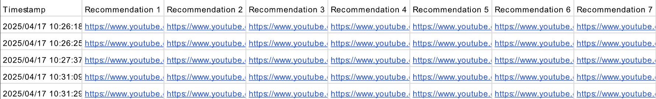
Google form:
https://docs.google.com/forms/d/1bJFQemColCBi_kE3RTBzqG8JjvTRd-hwfCbSYvtuPdo/edit?ts=67fd1232

Slide 3
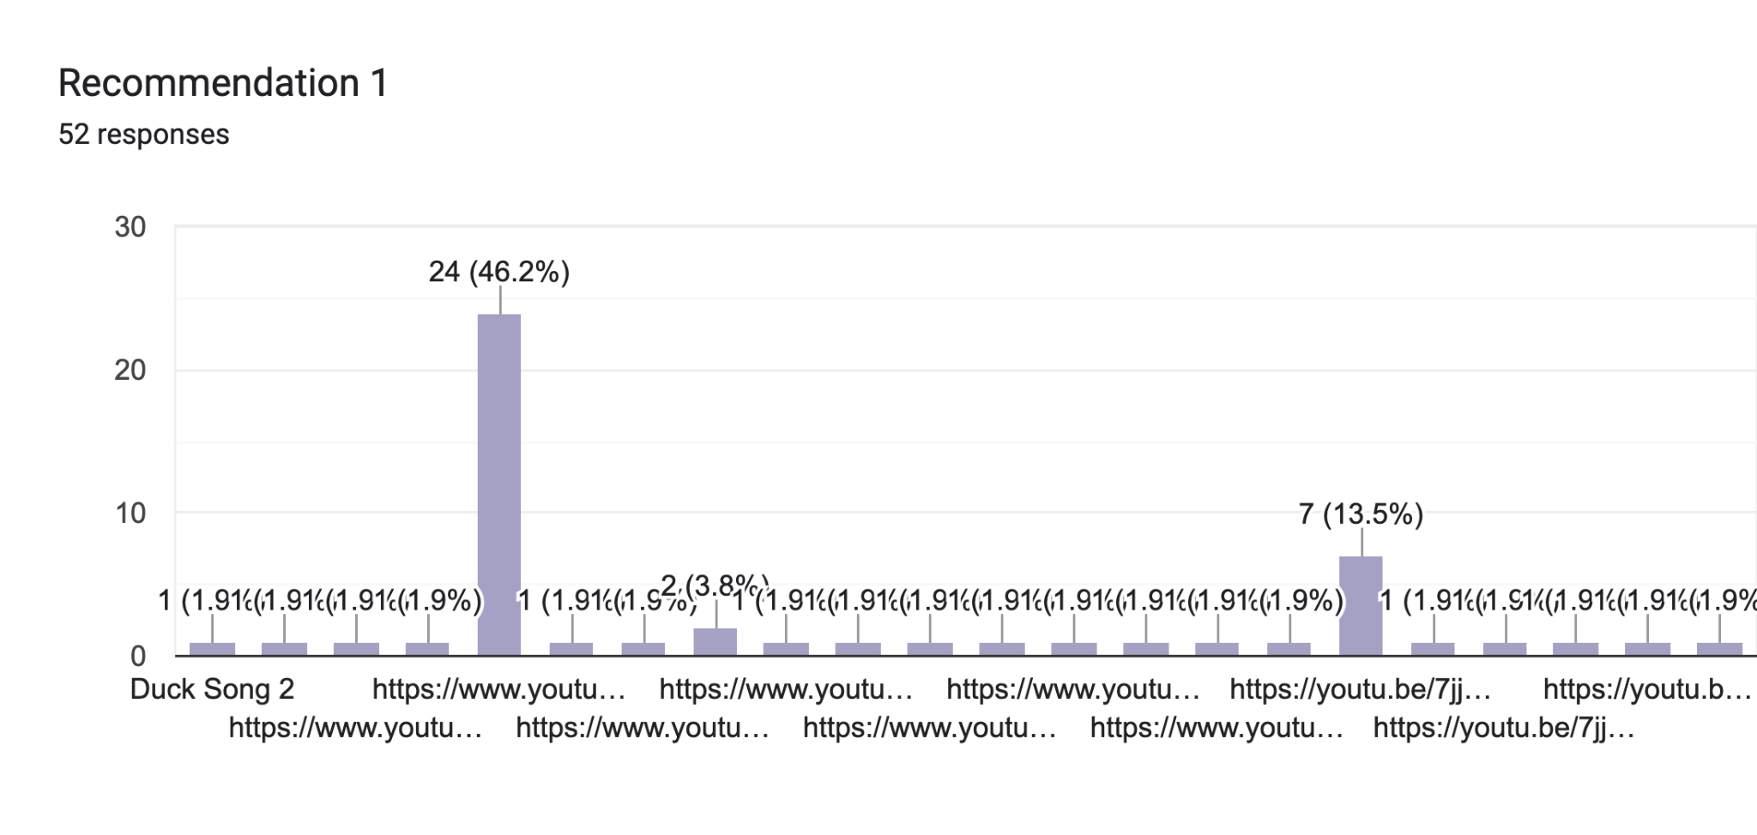
Question 1 - Personalized recommendations

Slide 4
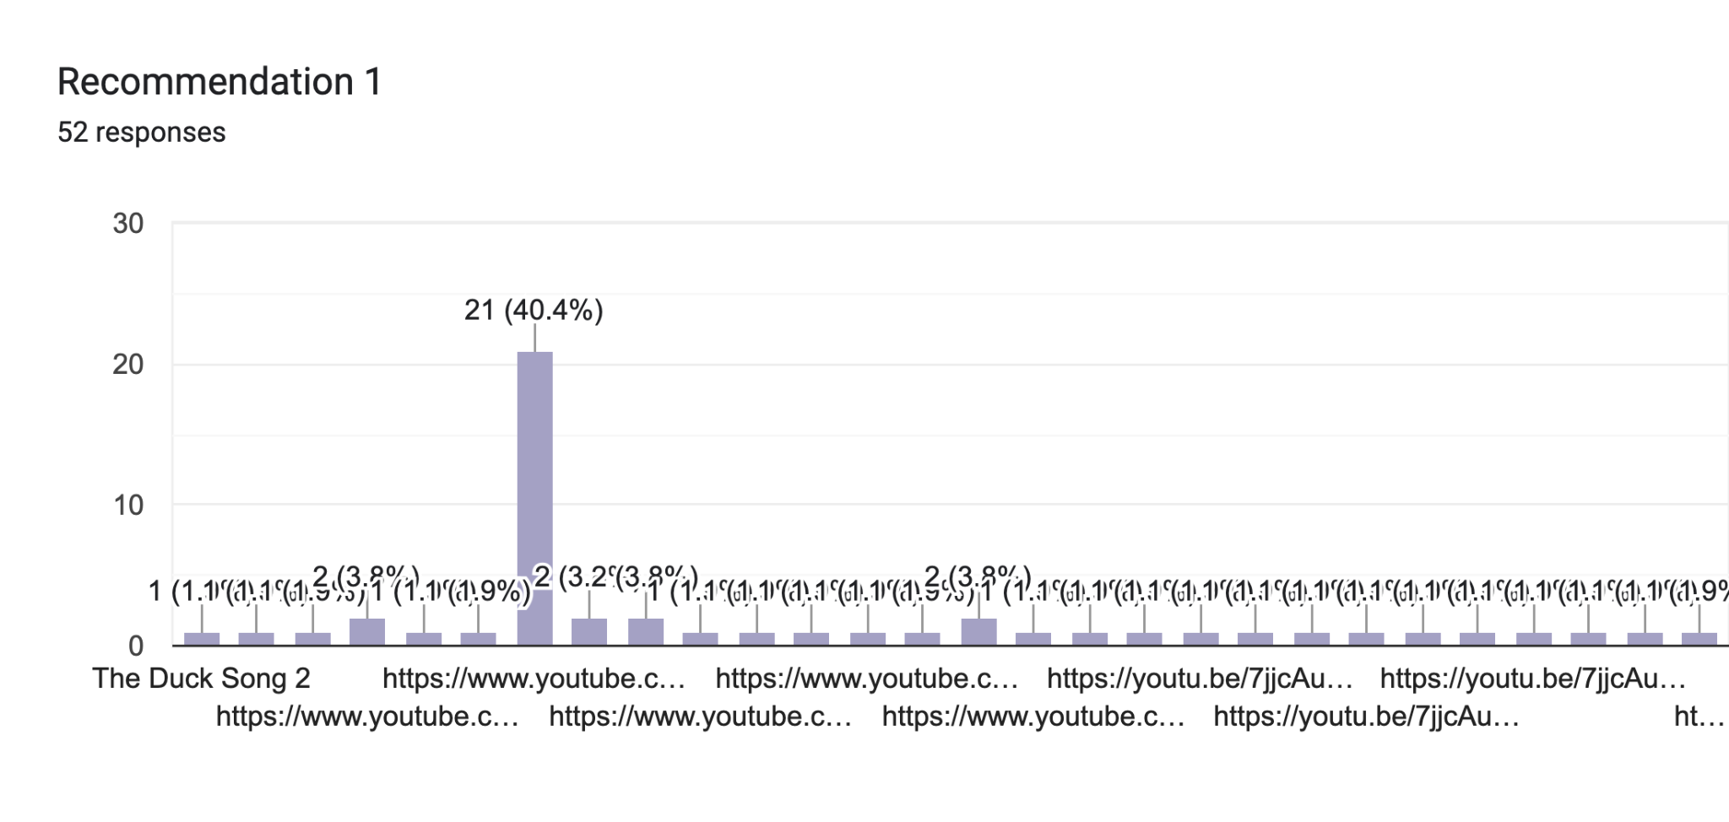
Question 11 - Non-Personalized recommendations

Slide 5
In total …
43 students in this class filled the survey
20 x 43 = 860 inputs of personalized or non-personalized recommendations
Data cleaning
21 entries were deleted because they were not valid links.
15 entries were deleted because they were playlists.

Slide 6
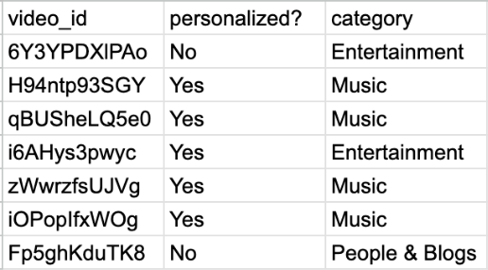
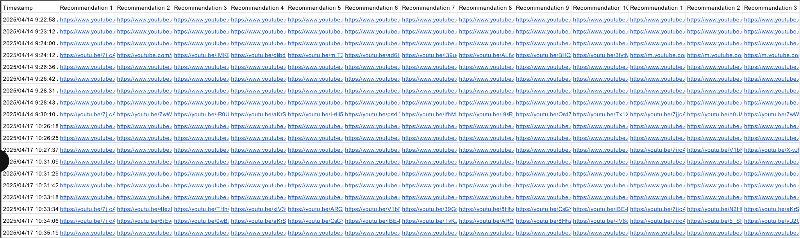
Data Process Workflow
Survey Inputs
YouTube API
Raw Data
Processed Statistics
One row is a survey input from the google form.
One individual is a video link.
What are the variables?
Variable 1: personalized or non-personalized;
Variable 2: category of the video;
Notes:
Need to update the personalized or not col with the same pic size

Slide 7
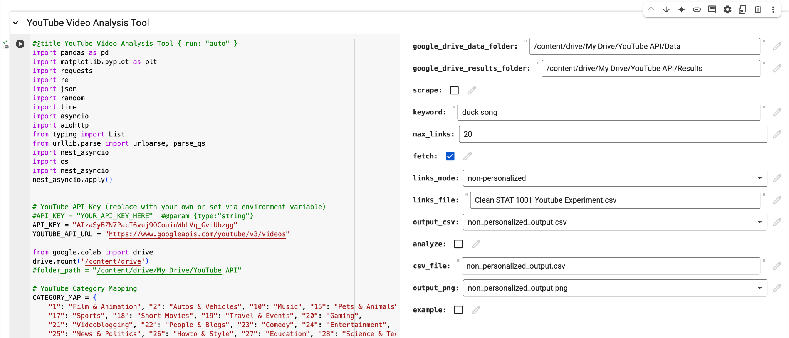
How did we do it?

Slide 8
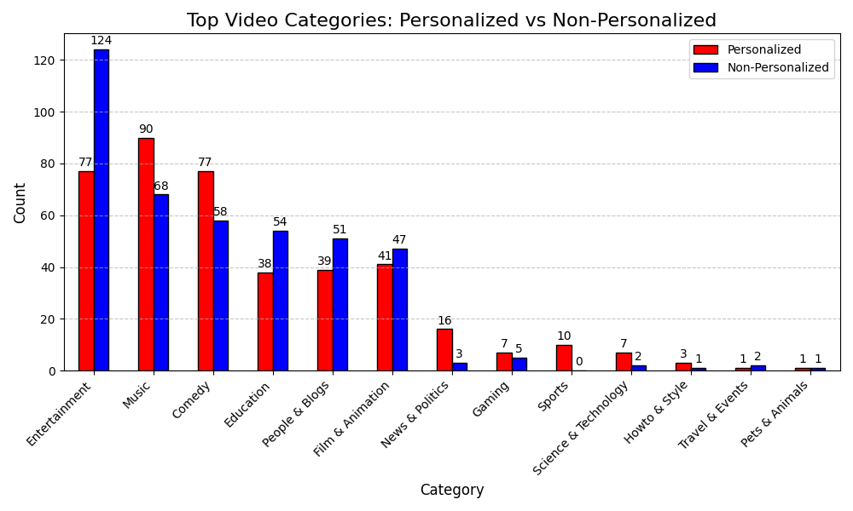
How do we analyze the data? → Statistics
Red: 407 videos
Blue: 416 videos
Notes:
Walk students through x-y axis
1st circle: entertainment is the top category for both modes
2nd circle: effect of personalization
Both personalized&non-personalized start from the same anchor video

Slide 9
A simpler two-way table
 |  | Recommendation Type
 |  | Personalized | Non-personalized | Total
Video category | Entertainment
 | Other
 | Total
Notes:
Need a simpler 2-way table
Personalized vs Non-personalized (need to change for all plots->done)
Fill out the numbers in-class, print out the worksheet?

Slide 10
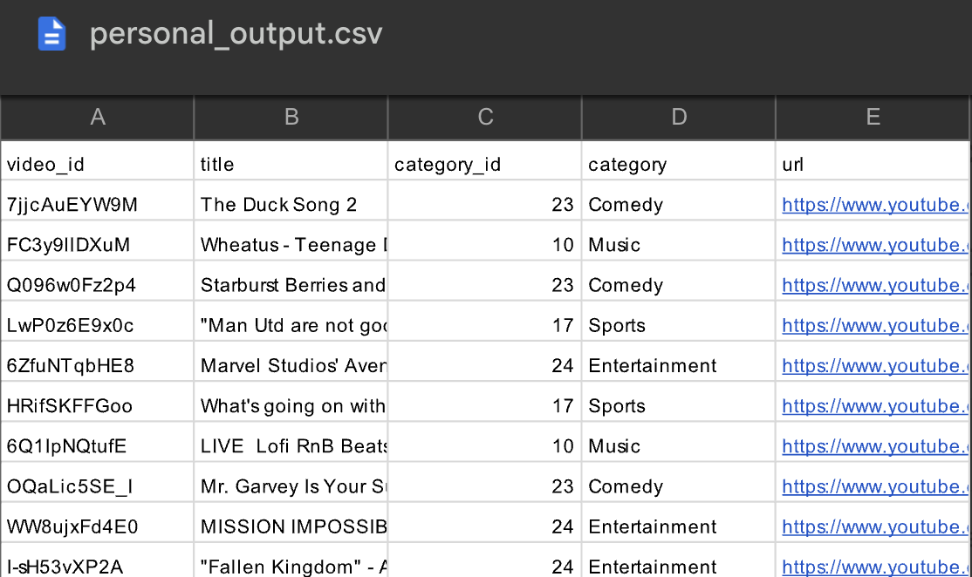
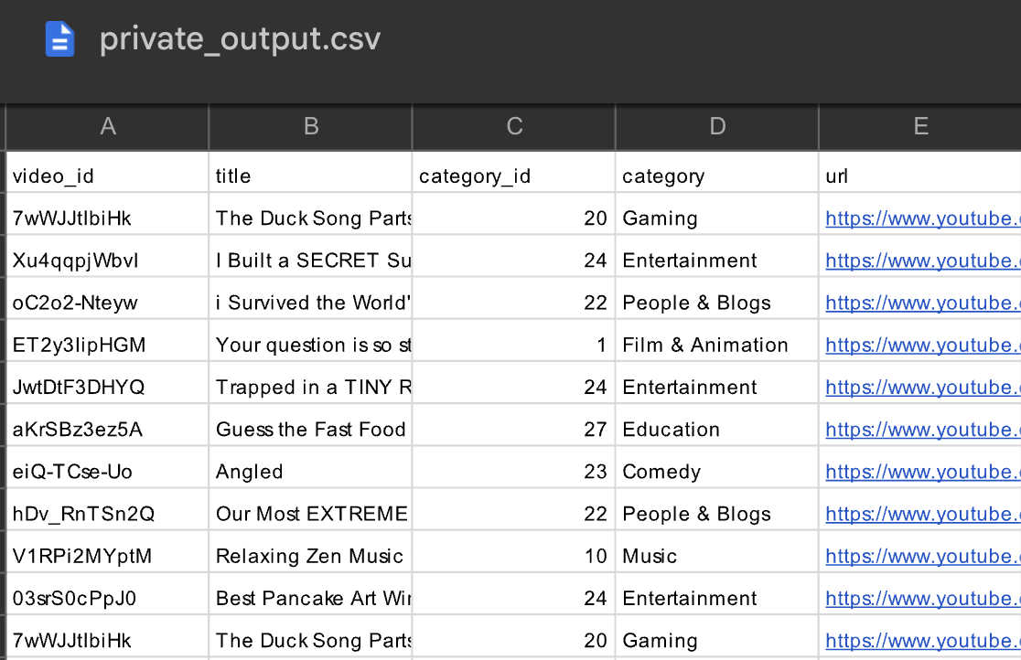
Data
raw raw data:
row: each student
col: 10 personalized + 10 private + comments
raw data:
under personal or private mode:
row: each youtube video
col: video category
(Entertainment, Music, Comedy…)

Slide 11
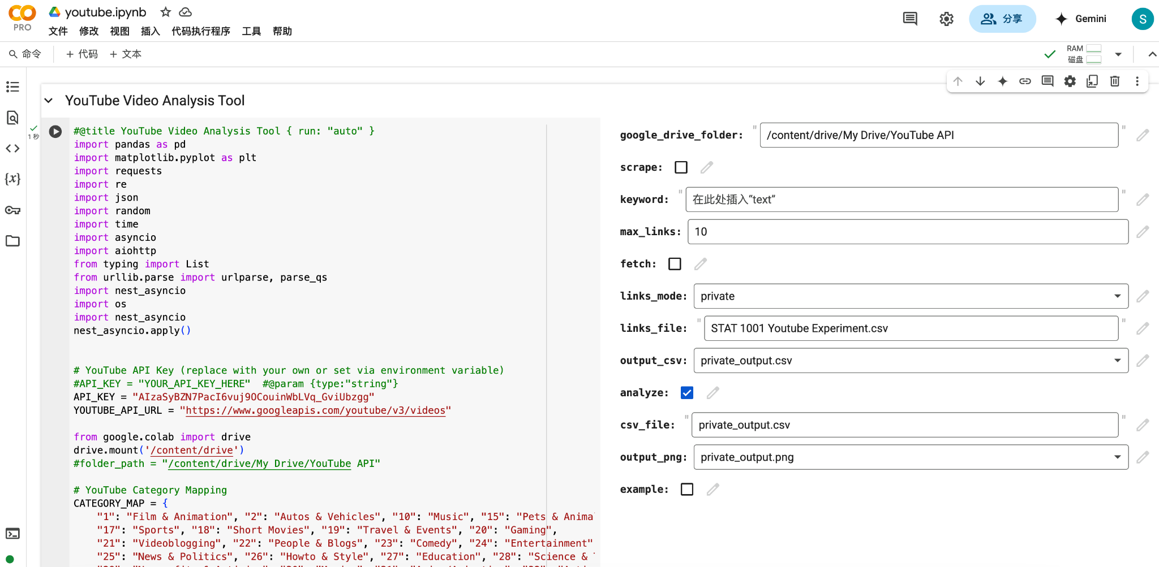
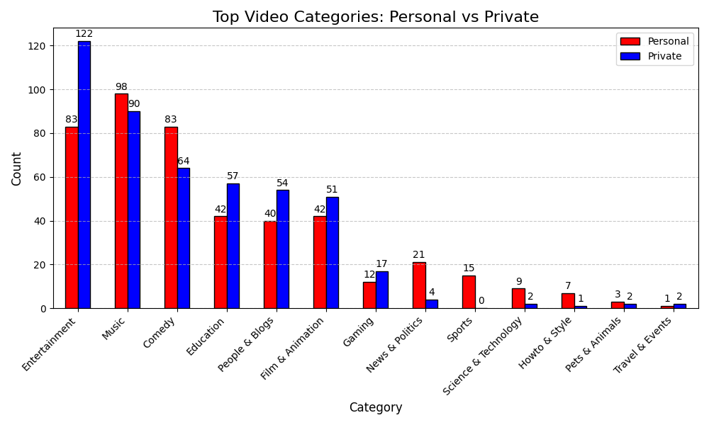
Data Processing
Top-Category Analysis
user-friendly-interface for API-calls and data processing
3 modules
scrape: search youtube video for a given keywords(eg “duck song”) and record the first few recommended videos (up to max # that you specify)
fetch: under a mode(personal/private/both), process the raw-raw data to obtain the raw data, extracts the video metadata(can be category, title, id…) through API-calls, and converts each video link to a category.
analyze: visualize the top categories of the raw data.
Next?
latest google-form data(~48 responses)
select which categories?

Slide 12
A simpler two-way table
 |  | Recommendation Type
 |  | Personalized | Non-personalized | Total
Video category | Entertainment | 77 | 124 | 201
 | Other | 330 | 292 | 622
 | Total | 407 | 416 | 823
Notes:
Need a simpler 2-way table
Personalized vs Non-personalized (need to change for all plots->done)
Fill out the numbers in-class, print out the worksheet?

